Slide 1


Fungi structure and classification
Lecture 9
Prof. Dr. Munira Ch. Ismaeel
Ass. Prof. Dr. Israa AJ Ibrahim

Slide 2

Fungi structure and classification Lec. 9
Prof. Dr. Munira Ch. Ismaeel and Ass. Prof. Dr. Israa AJ Ibrahim

Slide 3
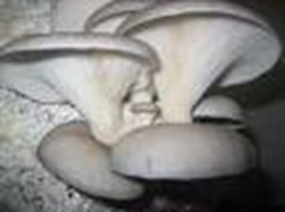
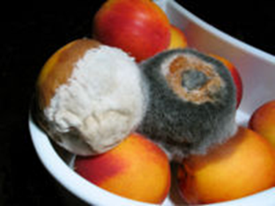
The Characteristics of Fungi
-Fungi are eukaryotic organisms.
-They reproduce by means of spores.
-Depending on the species and conditions both sexual and asexual spores may be produced.
-They are typically non-motile
-The organisms in kingdom fungi include mushrooms, yeasts, molds, rusts, smuts, puffballs, truffles, morels, and molds.
- More than 70,000 species of fungi have been identified. They live everywhere in air, in water, on land, in soil, and on or in plants and animals.
-Some fungi are microscopic and other extend for more than a thousand acres.
- Fungi are not capable of producing their own food, so they get their nourishment from other sources.
-Fungi are in a wide variety of sizes and forms and have great economic importance.
-The cell wall of fungi are mostly made up of carbohydrate chitin, while the cell wall in plants is made of cellulose.
-Nutrition in fungi - they are saprophytes, or parasites.
-All fungi require water and oxygen (no obligate anaerobes).

Slide 4
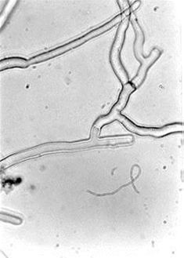
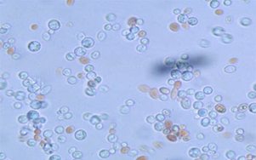
Body form
The vegetative body of the fungi may be unicellular or composed of microscopic threads called hyphae
filamentous (tube-like strands called hypha (singular) or hyphae (plural)
mycelium = aggregate of hyphae
sclerotium = hardened mass of mycelium that generally serves as an overwintering stage.
multicellular, such as mycelial cords, rhizomorphs, and fruit bodies (mushrooms)
Fungi are heterotrophic organisms, they obtain their nutrients by absorption (the fungi produce exoenzymes).
Fungi store their food as starch.
Fungi get carbon from organic sources.
Hyphal tips release enzymes.
Enzymatic breakdown of substrate.
Products diffuse back into hyphae.
Hyphae (Tubular, Hard wall of chitin, Cross walls may form compartments (± cells), Multinucleate, Grow at tips).
Spores - asexual (product of mitosis) or sexual (product of meiosis) in origin.

Slide 5
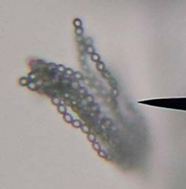
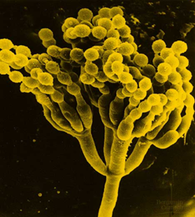
Purpose of Spores
Allows the fungus to move to new food source.
Resistant stage - allows fungus to survive periods of adversity.
Means of introducing new genetic. combinations into a population.
Reproduce by spores:
▪ Spores are reproductive cells
▪ Sexual (meiotic in origin)
▪ Asexual (mitotic in origin)
▪ Formed: Directly on hyphae,
Inside sporangia, Fruiting bodies.

Slide 6
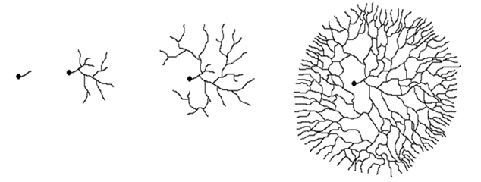
Hyphal growth from spore
Germinating spore
mycelium

Slide 7
Human- Fungus Interactions
Beneficial Effects of Fungi
-Decomposition - nutrient and carbon recycling.
-Biosynthetic factories. Can be used to produce drugs, antibiotics, alcohol, acids, food (e.g., fermented products, mushrooms) .
-Model organisms for biochemical and genetic studies.
Harmful Effects of Fungi
-Destruction of food, lumber, paper, and cloth.
-Animal and human diseases, including allergies.
-Toxins produced by poisonous mushrooms and within food (e.g., grain, cheese, etc).
-Plant diseases.

Slide 8
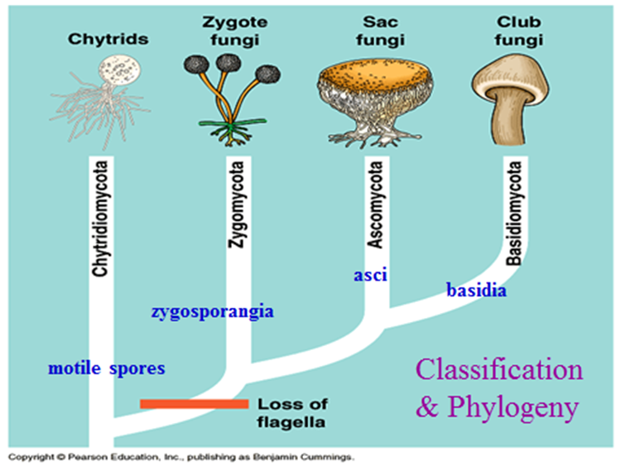
Classification of Fungi
The kingdom Fungi contains four major phyla that were established according to their mode of sexual reproduction or using molecular data.
The four true phyla of fungi are the :
a-Ascomycota (sac fungi),
b-Basidiomycota (club fungi)
c-Zygomycota (conjugated fungi)
d-Chytridiomycota (Chytrids)

Slide 9
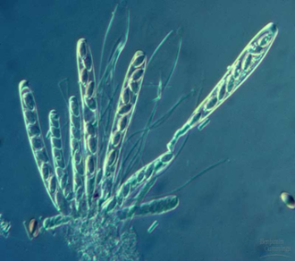
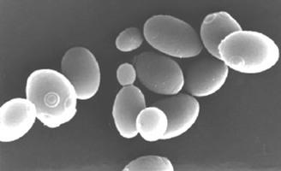
Kingdom Fungi Classification
Based on the spore case in which the spores are produced fungi are classified into four divisions:
1-Division Ascomycota: Sac Fungi
-The sac-fungi produce spores in small cup-shaped sacs called asci, hence the name ascomycota.
-The mature sac fungi spores are known as ascospores, they are released at the tip of the ascus breaks open.
-Yeast is the most common one-celled fungi.
-Yeast reproduces through asexual process called budding.
- Ex. yeast- Saccharomyces
-The buds form at the side of the parent cell, they pinch-off and grow into new yeast cell which is identical to the parent cell.
-Examples of sac-fungi are: Aspergillus.

Slide 10
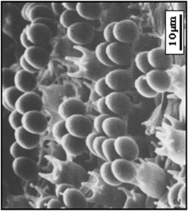
Division Basidiomycota: Club Fungi
-Basidiomycota includes the mushrooms, …..ets.
-The spores are borne on a club-shaped spore case called basidium.
- In mushrooms the basidia are lined at the gills under the cap. Huge numbers of spores are produced by the club fungi.
-In fact, an average sized mushroom produces over 16 billion spores. These spores rarely germinate or mature. Example: Agaricus (mushroom), Ustilago (smut), and Puccinia (rust fungus).

Slide 11
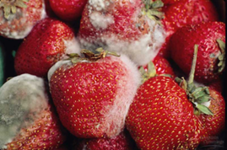
Division Zygomycota: Zygote forming Fungi
- These fungi are usually found on cheese, bread, plant and other decaying food.
-They are zygote forming fungi, hence the name zygomycota.
-The spores are produced in round-shaped case called sporangium.
-The grayish fuzz seen on bread and decaying food is actually mass of mature sporangia mold. Under the microscope they are seen as pinheads.
-When the sporangium breaks open hundreds of spores are released.
- Example: Mucor, Rhizopus (the bread mould) and Albugo.

Slide 12
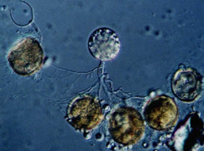
Division Chytridiomycota (Chytrids):
-Simple fungi
-Produce motile spores – zoospores-
- Mostly saprobes and parasites in aquatic habitats.

